Slide 1
Re(constructing) Professional Identities: Two Chinese Student Teachers’ Practicum Experiences in The Free Teacher Education (FTE) Program
Gang Zhu
Advisor: Dr. Cheryl Craig
College of Education, University of Houston

Slide 2
Crafting my professional identities: Parallel stories

Slide 3
Research Context
The K-12 school system in China is highly imbalanced between urban and rural schools (Wang, 2011a, 2011b; Chu, 2009; Hannum, 1999; Li, Huang, &Li, 2010).
The FTE program is a political means to coordinate the redistribution of educational resources, which has the potential to promote educational equity for school-age children in China (Hu, 2007; Sun, 2007; Yang & Wang, 2007).
The FTE program relies heavily on utilitarian, particularly financial, incentives to attract candidates. (Fang & Qi, 2011; Li, 2010; Li & Xu, 2011; Ye, Sun, Liu, Zhu, & Xiao, 2010; Zhou, 2010.)

Slide 4
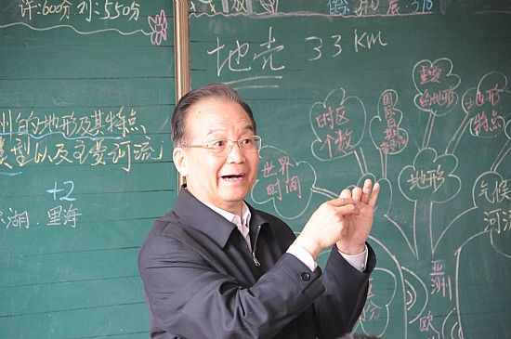
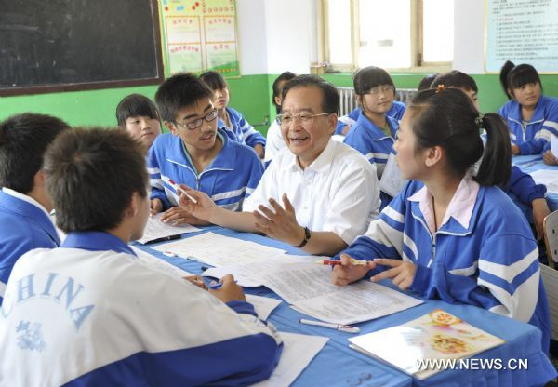
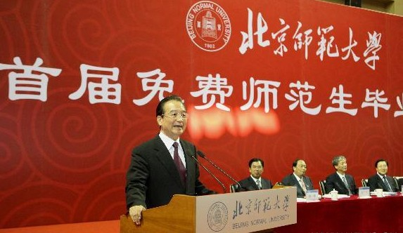
Free Teacher Education (FTE) program in China
The Ministry of Education, PRC initialized the FTE program in 2007

Slide 5
The landscape of Free Teacher Education (FTE) program in China
Free Teacher Education (FTE) Program
Beijing Normal University
East China Normal University
Northeast China Normal University
Central China Normal University
Southwest University
Shaanxi Normal University

Slide 6
Free Teacher Education (FTE) program in China
Benefits: tuition exemption, free accommodation, and a monthly stipend for 4-collge year.
Responsibility: (1) Serve for a period of ten years in primary or secondary schools in their home provinces. (2) Teach in rural schools for two years first.
If not: (1)Refund all educational costs, (2)Pay a certain amount penalty, (3)Being blacklisted in the Credit Record Archives.

Slide 7
Theoretical Framework
Professional identity is an ongoing process which entails the making sense and and re-interpretation of experiences (i.e. Kerby, 1991; Gee, 2001; Sach, 2001a; Beijaard, Meijer, & Verloop, 2004);
Professional identity implies both person and context. A teacher’ professional identity consists of sub-identities that more or less harmonize(Beijaard, Meijer, & Verloop, 2004).
From the sociocultural perspective, teacher identity is both a product (a result of influences on the teacher) and a process (a form of ongoing interaction within teacher development) (Olsen, 2008; Sfard & Prusak, 2005).

Slide 8
Research Questions
How do the FTE student-teachers (re)construct their professional identities in the practicums?

Slide 9
The multiple contexts of professional identity
University Supervisor
National Curriculum Reform Policy
University-based Teacher Education Coursework
FTE Student-teachers’ Professional Identity in the Practicum
Placement Schools
Cooperative Teacher
Knowledge Communities
FTE program policy
Subject Matter

Slide 10
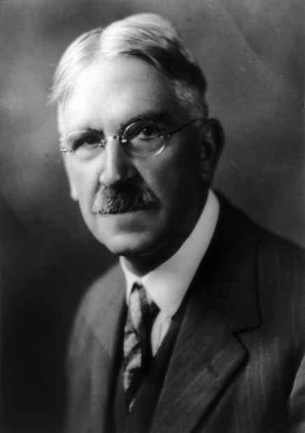
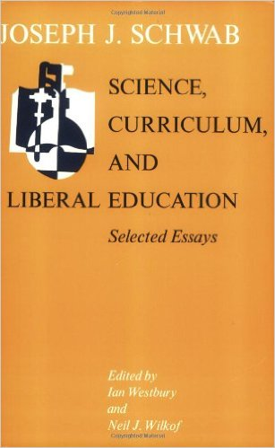

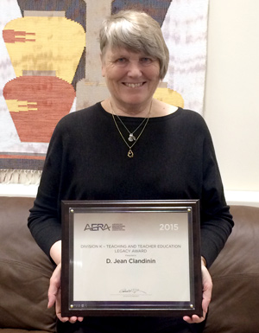
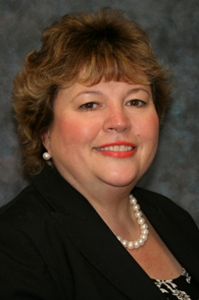
Methodology backdrop: Narrative inquiry
John Dewey
Joseph Schwab
Connelly& Clandinin
Cheryl Craig

Slide 11
A three-dimensional inquiry space
time (temporality)
interaction (sociality)
place (context)

Slide 12
Introducing Research Participants Xiaoya and Wenting
Xiaoya (pseudonym) :“Teaching is the most powerful weapon to change the kids’ destine.”
Wenting (pseudonym): “I am not competitive in terms of my pedagogical skills…”

Slide 13
Narrative Analysis and Representation
Broadeningburrowing, storying and re-storying
(Connelly & Clandinin, 1990)
“Telling stories” method
(Craig, 1997)
Story constella-tions
(Craig, 2007);
Parallel stories
(Craig, 1999)

Slide 14
Proposed Timeline
4-8
Read and reflect more related literatures.
9-10
Develop dissertation proposal and defend it.
11
Observe student teaching and create field notes. Living and storying, reliving and re-storying.

Slide 15
Q&A
Thank you!

